Slide 1

Usage and Care
Updated August 2014

Slide 2
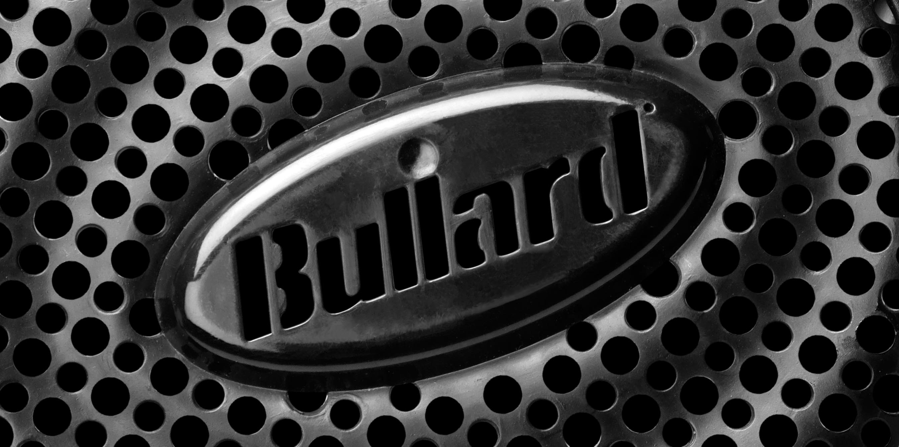
Thank You for Choosing EVA

Slide 3
Table of Contents
Chapter 1: Pre-Donning Checks
Chapter 2: Proper Donning
Chapter 3: Proper Use
Chapter 4: Proper Doffing
Chapter 5: Proper Maintenance
Chapter 6: Proper Storage
Chapter 7: Technical Support

Slide 4
Chapter One:
Pre-Donning Checks

Slide 5
Before You Don:
• Review System Components
• Review Key Specifications
• Review User Manual
• Pre-Operational Checklist

Slide 6

System Components
• EVA is NIOSH Approved
• An EVA PAPR System consists of four components:
▪ Hood or Mask
▪ Breathing Tube
▪ Blower Assembly
▪ Purifying Filter Cartridge
1
2
3
4

Slide 7
User Manual
• Warnings, Cautions, Limitations
• Principles of Operation
• Battery Pack
• Pre-Operational Checklist
• Mounting the Breathing Tube
• Checking Air Flow
• Air-Purifying Elements
• Mounting and Replacing Cartridges
• Donning the Blower
• Low Battery Alarm
• Troubleshooting
• NIOSH Approval Label
• Ordering Information
• Cleaning and Storage

Slide 8
Warnings
The EVA Series respirator does not supply oxygen. Use only in adequately ventilated areas containing at least 19.5% oxygen.
Do not use when concentrations of contaminants are immediately dangerous to life or health (IDLH) as defined in 20CFR1910.134(b).
Do not use these respirators for respiratory protection during abrasive blasting or clean up.
Do not use in circumstances where the airborne concentration level of contaminant exceeds the maximum use concentration for this type of respirator as established by regulatory standards.

Slide 9
Warnings
Leave the area immediately if:
  • Breathing Becomes Difficult
  • Dizziness or other distress occurs
  • You taste or smell the contaminant
  • The unit becomes damaged
  • The battery alarm activates
  • The low flow alarm activates

Slide 10
Warnings
This apparatus must not be worn with the blower unit switched off as it may cause a rapid build-up of carbon dioxide and depletion of oxygen, which could result in death or serious injury.
Never alter or modify this respirator. Use only Bullard NIOSH-approved EVA Series components and replacements and replacement parts for this respirator.
This device is not immune to highly powered RFI/EMI emissions.
*Failure to follow these warnings could result in death or serious injury.

Slide 11
Cautions
1. Not for use in atmospheres containing less than 19.5% oxygen.
2. Not for use in atmospheres immediately dangerous to life or health.
3. Do not exceed maximum use concentrations established by regulatory standards.
4. Do not use respirator if airflow is less than four cfm (115 lpm) for tight fitting facepieces or six cfm (170 lpm) for hoods and/or helmets.
5. Follow established cartridge and canister change schedules or observe ESLI to ensure that cartridges are replaced before breatkthrough.

Slide 12
Cautions
6. Contains electrical parts that may cause an ignition in flammable or explosive atmosphere.
7. Failure to properly use and maintain this product could result in injury or death.
8. The Occupational Safety and Health Administration regulations require gas-proof goggles to be worn with this respirator when used against formaldehyde.
9. Follow the manufacturer’s user instructions for changing cartridges and/or filters.

Slide 13
Cautions
10. All approved respirators shall be selected, fitted, used and maintained in accordance with MSHA, OSHA, and other applicable regulations.
11. Never substitute, modify, add or omit parts. Use only exact Bullard replacement parts in the configuration as specified by the manufacturer.
12. Refer to the User’s Instructions and/or maintenance manuals for information on use and maintenance of these respirators.
13. NIOSH does not evaluate respirators for use as surgical masks.

Slide 14
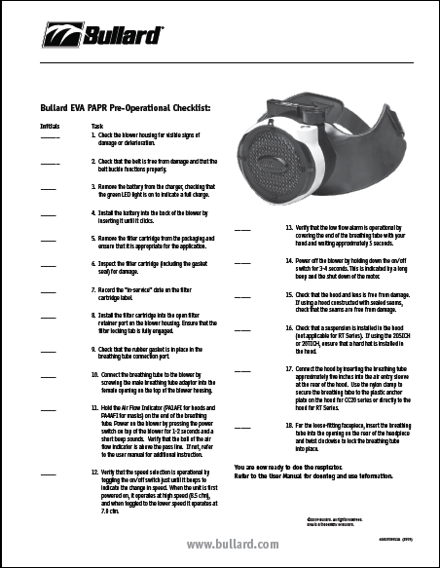
Pre-Operational Inspection
• Utilize the EVA Pre- Operational Checklist.
• Execute this checklist before donning.
• Physical inspection of blower, battery, belt, filter cartridge, hood, and breathing tube.
• Operational checks of air flow and low flow alarm.

Slide 15
Charging the Battery
Do not charge batteries in hazardous areas.
Plug the pronged connector of the charger power supply into the electrical outlet.
Plug the barrel connector of the charger power supply (aka brick) into the charger base.
Perform these steps before placing the battery in the cup.
Notes:
Video:
Bullets appear as the voice over announces them
Pan/zoom on each operational described
Powerpoint: Add pic
Voice:
To charge the EVA battery:
Select a safe location: Do not charge batteries in hazardous areas.
First, plug the barrel connector of the charger power supply into the charger base
Then, plug the pronged connector of the charger power supply into the electrical outlet
Finally, insert the battery (upside down) into the charger base
The power supply LED will illuminate RED while charging and Green when charging is complete
The EVA charger can charge an empty battery in approximately 4 hours

Slide 16
Charging the Battery
Insert the battery (upside down) into the charger base.
The power supply LED will illuminate RED while charging and GREEN when charging is complete.
The EVA charger can charge an empty battery in approximately 4 hours.
Notes:
Video:
Bullets appear as the voice over announces them
Pan/zoom on each operational described
Powerpoint: Add pic
Voice:
To charge the EVA battery:
Select a safe location: Do not charge batteries in hazardous areas.
First, plug the barrel connector of the charger power supply into the charger base
Then, plug the pronged connector of the charger power supply into the electrical outlet
Finally, insert the battery (upside down) into the charger base
The power supply LED will illuminate RED while charging and Green when charging is complete
The EVA charger can charge an empty battery in approximately 4 hours

Slide 17
Installing the Battery Pack
• Inspect the battery pack for physical damage.
• Place the battery pack into the blower by inserting into the battery compartment until the locking tab is engaged and clicks.
Note: The battery has built-in short circuit protection. In the event of a short circuit, an internal polyfuse will trip. The fuse will reset itself within 5-10 seconds allowing the battery to resume normal operation.

Slide 18
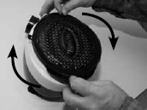
Inspecting and Installing the Filter Cartridge
• If new, remove from packaging and record “in-service” date on the label.
• Inspect the filter cartridge and its sealing gasket.
• If used previously, check the age versus change schedule.
Notes:
Video:
Bullets appear as the voice over announces them
Pan/zoom on each operational described
Powerpoint: Add pic
Voice:
To install an EVA filter cartridge follow these steps:
If new, remove from packaging and record “in-service” date on the label
Inspect the filter cartridge and its sealing gasket
If used previously, check the age versus change schedule
With the locking tab of the filter cartridge oriented as if toward the 11:00 position on a clock lower the filter cartridge into the blower port opening.
Turn the filter cartridge clockwise until the locking tab completely engages at the 12:00 position.

Slide 19
Inspecting and Installing the Filter Cartridge
• With the locking tab of the filter cartridge oriented toward the 11:00 position on a clock, lower the filter cartridge into the blower port opening.
• Turn the filter cartridge clockwise until the locking tab completely engages at the 12:00 position.

Slide 20
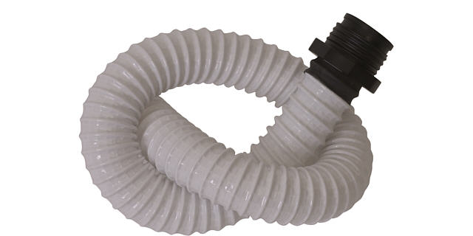
Inspecting & Installing the Breathing Tube
• Inspect the breathing tube for physical damage.
• Verify that a rubber gasket is in place in the breathing tube port of the blower unit.
• Screw threaded end of the breathing tube into the blower unit.
• Hand tight is sufficient.

Slide 21
Testing the Air Flow
• With gasket present in the breathing airway port, attach breathing tube to blower unit.
• With a filter cartridge installed, turn blower power on.

Slide 22
Testing the Air Flow
• Hold free end of breathing tube upright and place the Airflow Indicator into the end without blocking the outlet holes.
• Apply a slight downward pressure on the Airflow Indicator against the breathing tube to get a reasonable seal.
• If the ball is completely above the Pass Line then the system is ready for use.
Notes:
Video:
Bullets appear as the voice over announces them
Pan/zoom on each operational described
Voice
With gasket present in the breathing airway port attach breathing tube to blower unit
With a filter cartridge installed
Turn blower power on
Hold free end of breathing tube upright and place the Airflow Indicator into the end without blocking the outlet holes
Apply a slight downward pressure on the Airflow Indicator against the breathing tube to get a reasonable seal
If the ball is completely above the Pass Line then the system is ready for use

Slide 23
Testing the Low Flow Alarm
• Turn on the unit by pressing the on/off button of the blower and holding it down for 1-2 seconds until a short beep sounds.
• Then cover the breathing tube port with your hand and wait approximately 5 seconds.
• The 77dBA audible alarm will sound indicating a low flow condition of less than 170 lpm.
• Remove your hand from the breathing tube port and the alarm will cease when flow returns to normal.
Notes:
Video:
Bullets appear as the voice over announces them
Pan/zoom on each operational described
Powerpoint: Add pic
Voice:
To test the Press the on/off button of the blower and hold down for 1-2 seconds to turn the unit on
Then cover the breathing tube port with your hand and wait approximately 5 seconds
The 77dBA audible alarm will sound indicating a low flow condition of less than 185 lpm
Remove your hand from the breathing tube port and the alarm will cease when flow returns to normal

Slide 24
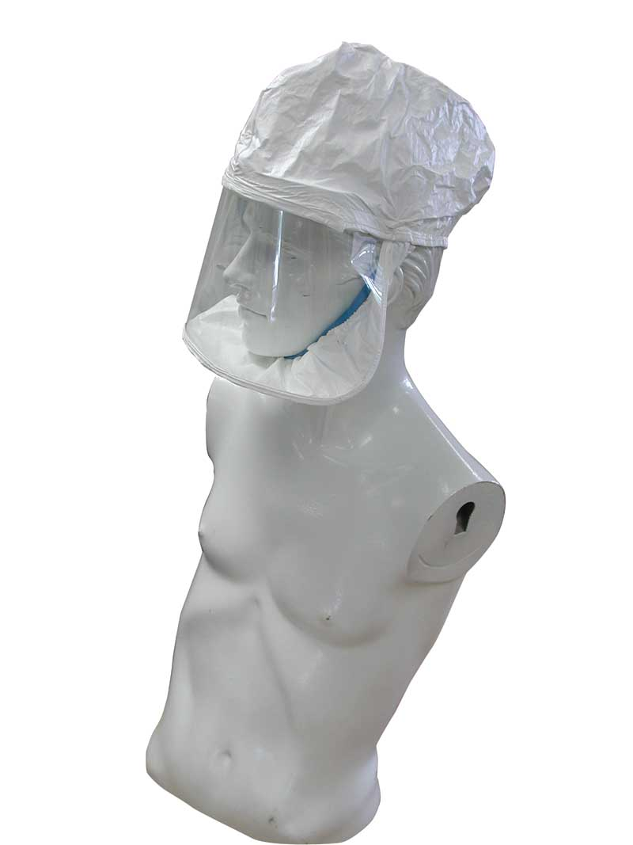
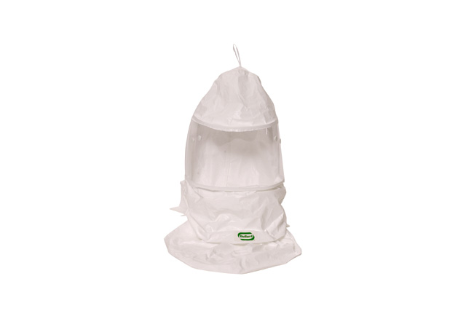
Inspecting Hoods
• Inspect for rips, tears, or damage from excessive wear.
• Inspect inner neck cuff (if applicable) for elasticity.
• Inspect lens for cracks, scratches, or any other signs of damage.
• Inspect headband (if applicable) for tears, cracks, or fraying straps.

Slide 25
Chapter Two:
Proper Donning

Slide 26
Donning
• Prepare to don in a safe, hazard free area.
• Install the battery, breathing tube, head piece and filters.
• Put belt and blower assembly onto waist.
• Adjust Belt as necessary.

Slide 27
Donning
• Switch the blower on.
• Place the hood on the head making any final adjustments to the fit as required for comfort and stability.
• If the hood has an inner bib then it should be tucked completely inside user’s shirt or coveralls.
Notes:
Video:
Bullets appear as the voice over announces them
Pan/zoom on each operational described

Slide 28
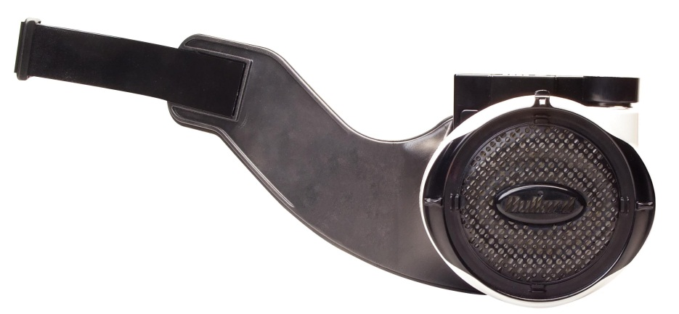
Installing the Belt
• With the blower filter side down, orient the lever locks as shown.
• Lay the belt over the blower as shown.
• Rotate the level locks until they are oriented as shown to secure the belt.
Notes:
Video:
Bullets appear as the voice over announces them
Pan/zoom on each operational described

Slide 29
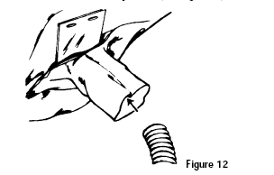
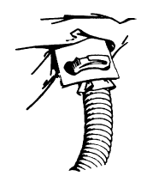
Installing a CC20 Series Hood
• Insert the breathing tube approximately 5” into the air entry sleeve at the rear of the hood and secure with nylon clamp and anchor plate.

Slide 30
Installing an RT Series Hood
• Insert the breathing tube approximately 5” into the air entry sleeve at the rear of the hood and secure with nylon clamp.
Note: RT Series hoods do not have anchor plates.
Notes:
Video:
Bullets appear as the voice over announces them
Pan/zoom on each operational described

Slide 31
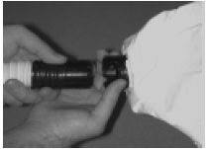
Installing a Loose Fitting Facepiece
• Bullard Loose Fitting Facepieces are designed for quick attachment.
• Insert the bayonet connector of the breathing tube into the hood connector and turn clockwise until it locks.
Notes:
Video:
Bullets appear as the voice over announces them
Pan/zoom on each operational described

Slide 32
Completed Donning
Notes:
Video:
Bullets appear as the voice over announces them
Pan/zoom on each operational described

Slide 33
Chapter Three:
Proper Use

Slide 34
Operating Temperature
The operating temperature should be:
  -5 C to 54 C
  23F to 129F
Below -5C (23F) the battery pack will shut down
At 50 C (122F) the unit will alarm to warn of high temperature
Above 54 C (129F) the battery pack will shut down

Slide 35
Principles of Operation
• The blower unit draws in ambient air through the filter cartridges.
• The purified air is blown into the wearer’s hood or facepiece through the breathing tube.
• A flow indicator is available to check that there is an adequate volume of air available to the wearer prior to use.
Notes:
Video: Something similar to the PA20 air flow animation.
Audio: Per the text on the slide.

Slide 36
Principles of Operation
• The system is designed to operate at a minimum air flow of approximately 7.0 cfm (210 lpm) in the hood on the standard speed setting and 8.5 cfm (240 lpm) on the high speed setting.
• A feedback loop from the Mass Flow Sensor to the impellor continually monitors and adjusts the air flow to keep it constant at the design set point.

Slide 37
Changing Airflow Speed
Turn the unit on by holding down the on/off switch for 1-2 seconds until a short beep sounds.
When the unit is first powered on it will operate on the high speed for maximum comfort and air flow. 8.5 CFM (240 lpm)
Pressing the on/off button and holding down until a short beep sounds will toggle the unit into the low speed setting for personal preference and lesser air flow. 7.0 CFM (200 lpm)
Additional button pushes will toggle the unit between the two speeds.
Notes:
Video:
Bullets appear as the voice over announces them
Pan/zoom on each operational described

Slide 38
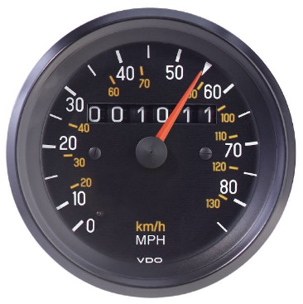

Active Flow Technology
Think cruise control for your PAPR
• Car cruise control
  Constant Speed
  Changing hill or gas tank conditions
• PAPR control
  Constant flow
  Changing Hood Types or Filter Cartridge Conditions
• Other PAPRs
  Indirect flow control via RPM or voltage
• EVA Active Flow Technology
  Unique feedback control loop that measures the flow directly with a mass flow sensor

Slide 39
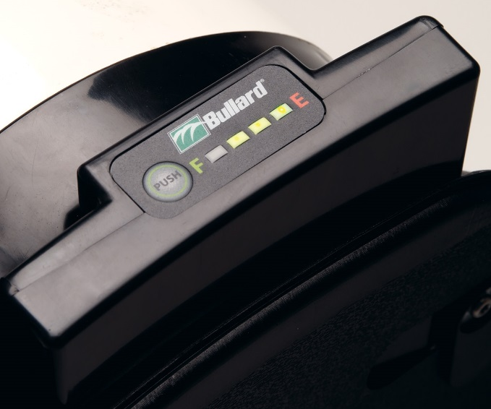
Battery Capacity
To check the capacity of an EVA battery simply press the Fuel Gauge button.
LEDs illuminate to display the remaining capacity in 25% increments.
When the battery is in an EVA blower and operating the Audible Low Battery Alarm, it will beep when approximately 20 minutes of battery run time remains.

Slide 40
Maximizing Battery Life
Remove the battery from the blower unit when not in use.
Charge the battery before it is completely discharged.
The low battery alarm indicates that the battery needs to be charged.
The battery is designed with a circuit to protect the battery and will not allow the battery to be discharged below a safe voltage for the cells, regardless of airflow, without the alarm sounding. When the battery reaches the voltage cutoff, it will automatically cease operation.
Notes:
Video:
Bullets appear as the voice over announces them
Pan/zoom on each operational described

Slide 41
Maximizing Battery Life
Always charge the batteries at room temperature or cooler.
At higher temperatures, the battery pack may not accept a full charge.
If the battery pack feels hot, let it cool for 30 minutes before charging.
Do not charge battery packs in an enclosed cabinet without ventilation.
Do not leave on the charger for more than 30 consecutive days.
Notes:
Video:
Bullets appear as the voice over announces them
Pan/zoom on each operational described

Slide 42
Trouble Shooting
• If the low flow alarm sounds check for:
  ▪ Clogged or damaged filters
  ▪ Blower malfunction
  ▪ Airway obstruction in hood or breathing tube
• If any part of the airflow indicator ball is below the Pass Line check for:
  ▪ Clogged or damaged filters
  ▪ Low battery charge or battery malfunction
  ▪ Blower malfunction
• If the low battery alarm sounds:
  ▪ Exit the hazardous area immediately
  ▪ Recharge the battery

Slide 43
Warning
• Leave the hazardous area immediately if:
    ▪ Breathing becomes difficult
    ▪ Dizziness or other distress occurs
    ▪ You taste or smell the contaminant
    ▪ Unit becomes damaged
    ▪ Low Voltage Alarm Sounds
• Do Not remove the respirator inlet covering, blower or waist-belt while in the hazardous area.
• After reaching a hazard-free area, immediately remove the hood and respirator.
• Do Not use a blower that fails the air flow test.
• Failure to observe these warnings could result in death or serious injury.

Slide 44
Chapter Four:
Proper Doffing

Slide 45
Doffing
• Do Not remove the respirator inlet covering, blower or waist-belt while in the hazardous area.
• After reaching a hazard-free area:
  ▪ Follow your facility’s SOPs for decontamination
  ▪ Remove Hood
    Discard or hang upright
    Do not tuck bibs inside hood or hang upside down
  ▪ Turn off blower by pressing the on/off button
  3-4 seconds until a long beep sounds and the
  motor shuts down.

Slide 46
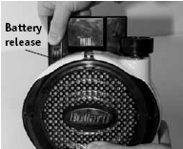
Removing the Battery
• Press the battery release on the pack to remove the battery from the back of the blower.
• Lift vertically.
Notes:
Video:
Bullets appear as the voice over announces them
Pan/zoom on each operational described

Slide 47
Removing the Belt
• With the blower filter side down, orient the lever locks as shown.
• Remove the belt from the blower.
• The plastic back plate may be removed for cleaning as shown.
Notes:
Video:
Bullets appear as the voice over announces them
Pan/zoom on each operational described

Slide 48
Chapter Five:
Maintenance
Notes:
Voice: Chapter Five: Maintenance

Slide 49
Maintenance
• No calibration or maintenance is necessary – just simple inspection.
• Inspect blowers, belts, batteries, breathing tubes, and hoods before and after each use.
• Check air flow with air flow indicator before each use.
• Check low flow alarm before each use.
Notes:
Video:
Bullets appear as the voice over announces them
Pan/zoom on each operational described

Slide 50
Cleaning
• Hoods
  ▪ Laundering is not recommended.
  ▪ Warm water and mild detergent may be used to hand-sponge.
  ▪ Rinse and then air dry.
  ▪ Mineral spirits may be used to remove paints or coatings from the solvent resistant lens 20TP and 20TPC hoods.
• Breathing Tubes
  ▪ Hand sponge with warm water and mild detergent, being careful not to get water inside.
Notes:
Video:
Bullets appear as the voice over announces them
Pan/zoom on each operational described

Slide 51
Cleaning
• Blowers
  ▪ EVA blowers have been laboratory tested to be safely cleaned with mild detergent, isopropyl alcohol (70% or less concentration), or chloride based wipes such as Sani-Cloth.
  ▪ If wearing the blower into a decon shower, filters should be left installed with shower caps and the blower kept running.
Notes:
Video:
Bullets appear as the voice over announces them
Pan/zoom on each operational described

Slide 52
Cleaning
• Batteries
  ▪ Hand sponge with mild detergent, isopropyl alcohol (70% or less concentration), or chloride based wipes such as Sani-Cloth.
• Belts & Belt Backplates
  ▪ Hand sponge with mild detergent, isopropyl alcohol (70% or less concentration), or chloride based wipes such as Sani-Cloth.

Slide 53
Chapter Six:
Storage

Slide 54
Respirator Storage
Store the respirator and its components where they will be protected from contamination, distortion, and damage from elements such as dust, direct sunlight, heat, extreme cold, excessive moisture and harmful chemicals.
The storage temperature should be:
  -5 C to 54 C
  23F to 129F

Slide 55
Battery Storage
Store where they will be protected from contamination, distortion, and damage from elements such as dust, direct sunlight, heat, extreme cold, excessive moisture and harmful chemicals.
The storage temperature should be:
  -5 C to 54 C
  23F to 129F
Unlike NiMH batteries, very little self discharge occurs with Li Polymer batteries
Discharging and re-charging the battery full at least once every 3 months is suggested to ensure the longest possible life of the battery.
For long-term storage, it is best to store the battery with at least 40% charge still remaining.

Slide 56
Chapter Seven:
Technical Support

Slide 57
Call 1-877-Bullard or visit www.bullard.com
For More Information

